Slide 1
Primary 2/3 Curriculum Meeting
September 2020

Slide 2
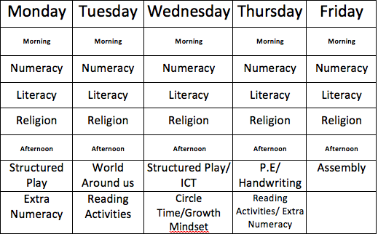
P.2/3 Timetable

Slide 3
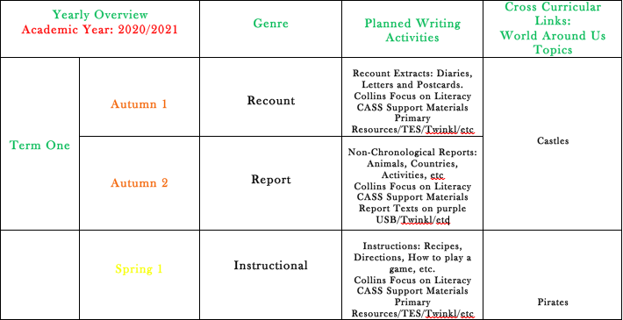
Literacy Long Term Plan

Slide 4
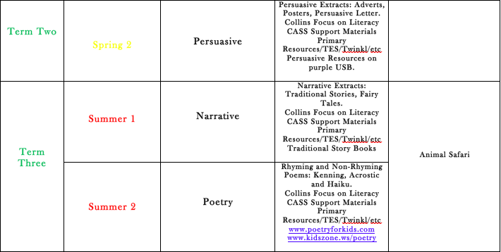
Literacy Long Term Plan

Slide 5
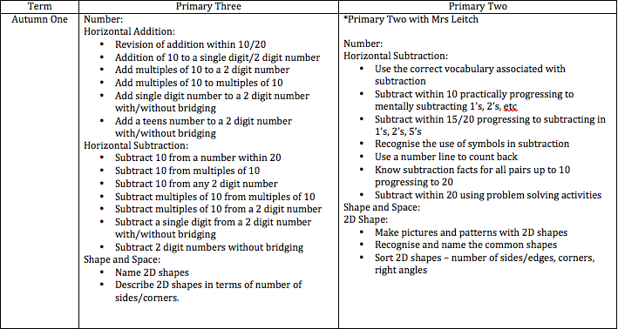
Numeracy Long Term Plan

Slide 6
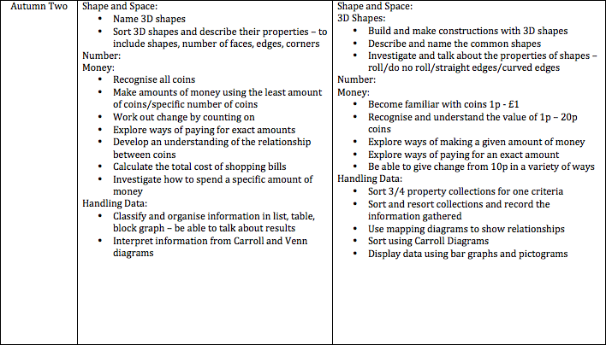
Numeracy Long Term Plan

Slide 7
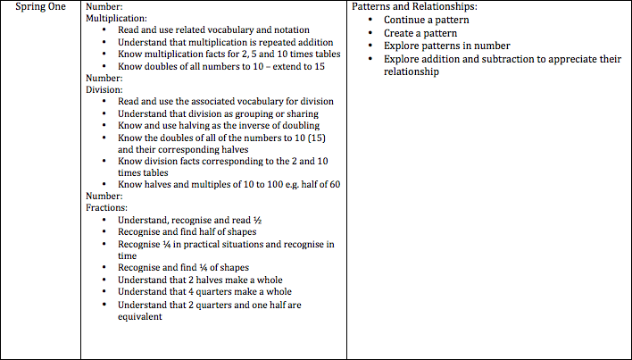
Numeracy Long Term Plan

Slide 8
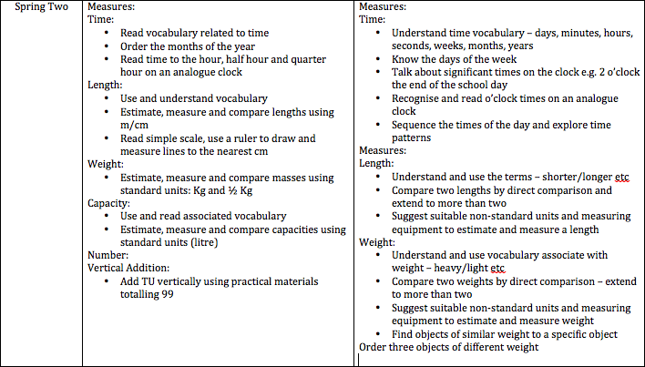
Numeracy Long Term Plan

Slide 9
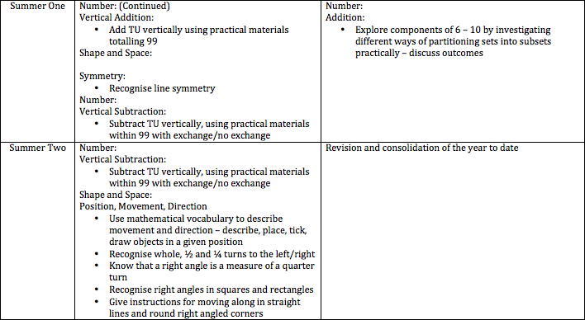
Numeracy Long Term Plan

Slide 10
P.2 Work with Mrs Leitch
Literacy
Revision: Letters/Phonics:
A, E, I, O, U, S, A, T, I, P, N, C, K, E, H, R, M, D, G, O, U, L, F, B, J, Z, W, Y, X
*Action and jingle for each sound
*Letter formation
*Naming words that begin with each sound
*Vowels as the middle sound and write the missing vowels
*Activities: word/picture match, initial sound/picture match activities, alphabet jigsaw
*Writing initial and ending sounds for given words
*CVC words: writing words beginning or containing these letters, fill in missing letters-consonants
*Word blending CVC words (possibly CCVC)
*Spelling CVC words (possibly CCVC)
*Picture/word match and spell
*Pie Corbett Reading Spine Books Year 1 (P2)
*Spellings: Prime-Ed Book A: Units 1, 2, 3 and 4

Slide 11
P.2 Work with Mrs Leitch
Numeracy
*Mental Maths
-counting 0-20 and 20-0
-counting on from any number up to 20
-adding on one to any number within 20
-2’s to 20
-5’s to 50
-10’s to 100
-doubles to 10+10
-halves to 20
Number
*Revision numbers 1-10
*Counting sets to 20/estimation
*Writing/ordering numbers to 20-missing numbers within 20
*Addition within 10/20
*Subtraction within 10/20
*Double and halves to 20

Slide 12

Growth Mindset

Slide 13

Full Attendance
Primary Two and Three
For full attendance pupils will receive a treat
It is equally as important to be on time as this can affect your attendance

Slide 14

Homework
Each night pupils are expected to read and complete their spelling tasks – to both read and spell the words in their wordlist.
Additional work/worksheets may also be sent home to complete – these are not to be returned to school – a photograph can be sent via SeaSaw.
Homework will also consist of:
Mental Maths Activities
Bug Club
Mathlethics

Slide 15

Bug Club
If anyone has problems getting logged on to Bug Club please let me know. It is important to sit with your child and listen to them read aloud. It is also very important to complete the comprehension bugs.

Slide 16

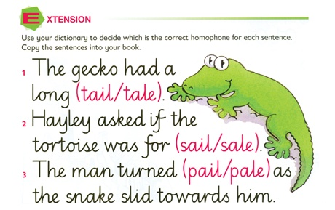
Handwriting
Big Focus on Handwriting and presentation of work this year
Weekly handwriting practice based on Nelson
Encourage pupils to use in class
Encourage to use at home for homework

Slide 17


Allergens/Special Diet
We are now a NUT FREE school.
If your child is allergic to anything or requires a special diet please let me know.

Slide 18

Education Authority - FSM
If you feel that you would be entitled to free schools meals please contact the school for the appropriate forms. Even if it would not be your intention at this stage for your child to avail of the free school meals and uniform to which they are entitled, it is still important that you register your entitlement as soon as possible.

Slide 19
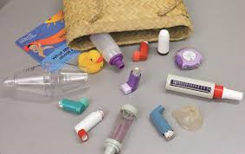
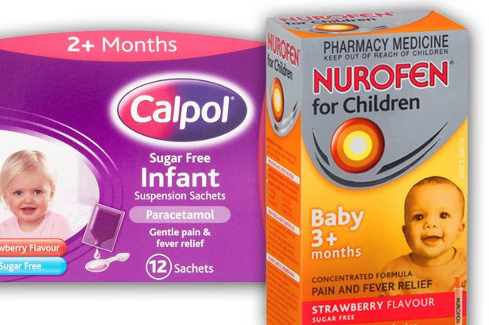
Medicine/Inhalers
Please ensure there is an in date inhaler in school if your child requires one.

Slide 20
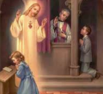
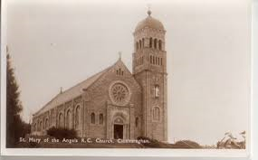
Awaiting Info for First Confessions

Slide 21
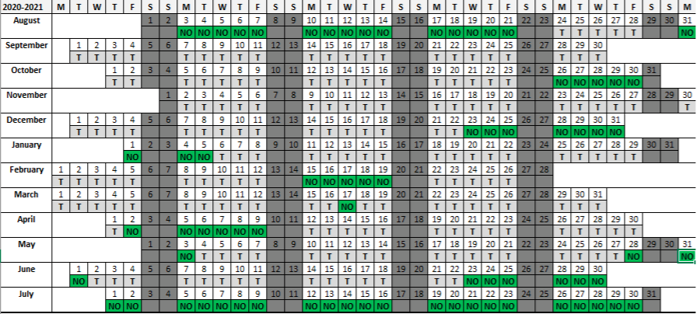
Holidays

Slide 22

Holidays
Keep up to date with all of our holidays on our school website:
www.stfrancispsdrumaroad.com

Slide 23
School Website/App

Slide 24

A partnership

